Slide 1
HS-PBIS COP #4 Data for Decision Making in High Schools Jessica Swain-Bradway, Ph.D. With contributions from the partners of the National PBIS TA Center www.PBIS.org
Wednesday, April 26, 2017
Notes:
HS-PBIS COP #4
ABC district – hosting the CoP
Wednesday, April 26, 2017 (High School Problem Solving Teams)
9:30 - 10:30 Jessica/Webinar: EXPLAIN and MODEL the Problem solving questions
10:30 - 11:30 Cristy /Processing Activity: Simulation for TIPS model - precision statement and goal setting
12:30 - 1:30 Jessica/Webinar: MODEL the link to behavior science, and implementation science what are the mechanisms to support adult behavior.
1:30 - 2:30: Cristy /Processing Activity: Simulation for TIPS model - solution plan

Slide 2
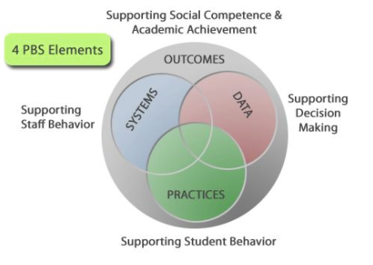
Notes:
In our high school PBIS work, we often “bend” to outcomes that are elementary. We fail to see that PBIS can be used to shape academic outcomes, academic enabling / supporting behaviors. We need to hone in on the desired outcomes, and then work backwards: what are the practices that support these outcomes? What are the systems that support the adults to implement these practices? What are the data that tell us if we are doing an effective job, and where to intentionally point our resource and efforts

Slide 3
ACTIVITY: Valued Outcomes
Write down the valued outcomes for your students.
Turn to two people next to you and share your valued outcomes.
Summarize all three of your valued outcomes in a few talking points.
Be prepared to share.

Slide 4
OUTCOMES
FIDELITY
Notes:
All of our work in PBIS ultimately comes back to the classroom. Everything we do in the classroom contributes to success, stagnation, or failure. The outcomes we want, are linked closely to the fidelity of our classroom work.

Slide 5
We Actually, Really, Super, Duper, Need Data…
Data help us be intentional, focused
Data-based decision making requires we are:
Precise
Targeted
Link data to present levels, goals, and progress
Weight fidelity and outcomes as equally important

Slide 6
Precision Problem Statements (What are the data we need for linking action plans?)
Precise problem statements include information about the five core “W” questions.
What is problem, and how often is it happening
Where is it happening
Who is engaged in the behavior
When the problem is most likely
Why the problem is sustaining
Notes:
This level of precision asks us to back out and look at our data systems…

Slide 7
ACTVITY: DATA- Haves & Needs
Considering your Valued Outcomes…
1. What data do you Have?
2. What Data do you Need? / Problems with Data?
Take a few minutes and write down the data you know you have to inform your valued outcomes…
Fidelity Data- including practices used by teachers
Outcome Data- including “small” units of data that show progress
Take a few minutes and write down the data you do not yet have to inform your valued outcomes…
Fidelity Data- including practices used by teachers
Outcome Data- including “small” units of data that show progress

Slide 8
Swain-Bradway, Putnam, Simonsen, Freeman, Lane, et al., in press
Notes:
9:30 - 10:30 Jessica/Webinar: EXPLAIN and MODEL the Problem solving question
PULL UP the Word document – explain each component.

Slide 9
A word about PREVENTION…
Prior to having to identify a specific problem, we can PREVENT and REDUCE any current issues by:
Improving fidelity of core features
We often KNOW what some of the biggest issues are…without a fidelity measure ;-)
I am not saying abandon fidelity measures…I AM saying working on boosting best practices is ALWAYS a good course of action.

Slide 10
Precision
What is problem, and how often is it happening
Where is it happening
Who is engaged in the behavior
When the problem is most likely
Why the problem is sustaining
Identify the main problem, the outcomes, you would like to improve. Be specific (who, what, where, when, and why).

Slide 11
Fidelity as a CORE FEATURE
Range of tools to identify the strengths and needs of fidelity
Systems (TFI, SAS, BOQ)
Practices (Self-assessments, checklists, observation protocols).
FIDELITY: Check if the Core Features are being implemented with Fidelity.

Slide 12
https://www.osepideasthatwork.org/evidencebasedclassroomstrategies/

Slide 13
Outcomes
Are we achieving them?
Who is “we”?
Disaggregate data by subpopulations.
ASSESSING OUTCOMES: Use data to determine if all individuals are making progress.

Slide 14
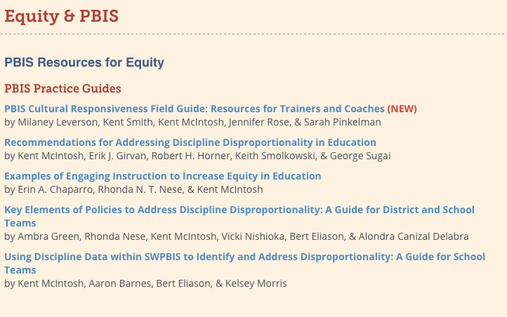
http://www.pbis.org/Common/Cms/files/pbisresources/PBIS_Disproportionality_Data_Guidebook.pdf

Slide 15
Action Planning
Action plans become “deeper” once we identify the data we need.
Linking data to behavioral strategies…(part 2 of today’s CoP)
ACTION PLAN: Develop a plan to enhance fidelity of core features and/or improve outcomes for individuals not making progress.
Notes:
Unless we know our data intimately, including how we are all doing, what we are all doing, we cannot action plan or implement a course of action to adequately address the problems.

Slide 16
ACTVITY: DATA- Haves & Needs
Have your ideas changed? Solidified?
RE-Considering …
1. What data do you Have?
2. What Data do you Need? / Problems with Data?
Take a few minutes and write down the data you know you have to inform your valued outcomes…
Fidelity Data- including practices used by teachers
Outcome Data- including “small” units of data that show progress
Take a few minutes and write down the data you do not yet have to inform your valued outcomes…
Fidelity Data- including practices used by teachers
Outcome Data- including “small” units of data that show progress

Slide 17
HS-PBIS COP #4 Data for Decision Making in High Schools - Linking Solutions to Data Jessica Swain-Bradway, Ph.D. With contributions from the partners of the National PBIS TA Center www.PBIS.org, and PBIS Apps www.pbisapps.org
Wednesday, April 26, 2017
Notes:
HS-PBIS COP #4
ABC district – hosting the CoP
Wednesday, April 26, 2017 (High School Problem Solving Teams)
9:30 - 10:30 Jessica/Webinar: EXPLAIN and MODEL the Problem solving questions
10:30 - 11:30 Cristy /Processing Activity: Simulation for TIPS model - precision statement and goal setting
12:30 - 1:30 Jessica/Webinar: MODEL the link to behavior science, and implementation science what are the mechanisms to support adult behavior.
1:30 - 2:30: Cristy /Processing Activity: Simulation for TIPS model - solution plan

Slide 18
Swain-Bradway, Putnam, Simonsen, Freeman, Lane, et al., in press
Notes:
9:30 - 10:30 Jessica/Webinar: EXPLAIN and MODEL the Problem solving question
PULL UP the Word document – explain each component.

Slide 19
Linking Solutions
Defining problems with precision is necessary for linking to proven strategies
“High Probability” strategies
Behavioral Science gives us the frame to address problems identified in data…
Notes:
12:30 - 1:30 Jessica/Webinar: MODEL the link to behavior science, and implementation science what are the mechanisms to support adult behavior.

Slide 20
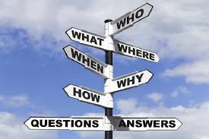
Precision
What is problem, and how often is it happening
Where is it happening
Who is engaged in the behavior
When the problem is most likely
Why the problem is sustaining
Identify the main problem, the outcomes, you would like to improve. Be specific (who, what, where, when, and why).

Slide 21
Solution Development & Action Planning
Prevention — How can we avoid the problem context?
Teaching — How can we define, teach, and monitor what we want?
Recognition — How can we build in systematic rewards for positive behavior?
Extinction — How can we prevent problem behavior from being rewarded?
Consequences — What are efficient, consistent consequences for problem behavior?
Data — How will we collect and use data for evaluation?
Notes:
What does

Slide 22
Solution Development & Action Planning
Solution Component | Action Step(s)
Prevention | How can we avoid the problem context? Ex: schedule lunch times, change lighting
Teaching | How can we define, teach, and monitor what we want? Ex: build “Quiet” curriculum, teach hallway expectations, buy decibel meter
Recognition | How can we build in systematic rewards for positive behavior? Ex: 3 quiet days = 5 extra minutes of social time (at lunch or end of day)
Extinction | How can we prevent problem behavior from being rewarded? Ex: public posting of results
Corrective Consequence | What are efficient, consistent consequences for problem behavior? Ex: continue current system (Major/Minor ODR)
Data Collection | Implementation fidelity? Ex: walkthrough reports, observations, self-assessments Impact on student outcomes? Ex: SWIS ODR data

Slide 23
ACTIVITY: Making connections
What does this solutions development process remind you of?
How close is this process to the one you use?
What are your strengths and needs in this area?
Prevention
Teaching
Recognition
Extinction
Corrective Consequences (re-teaching)
Data Collection

Slide 24
Supporting Adult Behaviors
The science of learning (high probability strategies) work for ALL learners
Clear expectations
Clearly communicated
Redundancy builds fluency
High rate of:
Opportunities to respond
Corrective feedback
Behavior Specific Praise

Slide 25
ACTIVITY: Supporting Adult Behaviors
So we developed a solution…no one is actually doing it!
What do your adult learning opportunities look like?
Model?
Practice?
Feedback
Do they receive ongoing feedback?
How often? When?

Slide 26
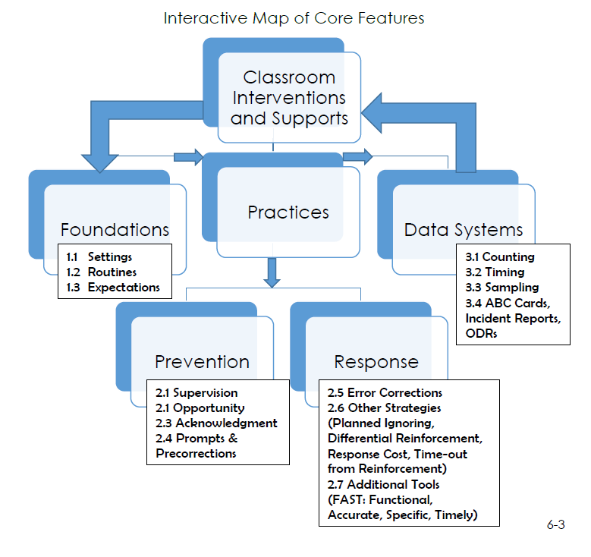
Notes:
For all of the things we want adults to do, to help achieve those valued outcomes…we need to use the high probability strategies.

Slide 27
Notes:
In our high school PBIS work, we often “bend” to outcomes that are elementary. We fail to see that PBIS can be used to shape academic outcomes, academic enabling / supporting behaviors. We need to hone in on the desired outcomes, and then work backwards: what are the practices that support these outcomes? What are the systems that support the adults to implement these practices? What are the data that tell us if we are doing an effective job, and where to intentionally point our resource and efforts

Slide 28
Thank you!
Thank you for participating.
The webinar will be posted at www.midwestpbis.org
Please visit www.PBIS.org for other high school resources.

